Slide 1
Bibliographic Citation and Referencing
Research Methods in Management

Slide 2
Academic Integrity
Academic Integrity means that you give complete and fair credit to the sources of the ideas you incorporate in your paper.
Plagiarism
Plagiarism is a Latin word means “to kidnap”
For example:
Copy another author’s sentence word-by-word and presenting them as yours.
Present another person’s ideas or logical arguments as yours without citing the source.

Slide 3
Citation and Referencing Styles
APA
MLA
Chicago
Harvard
Turabian
IEEE
Etc.

Slide 4
APA style
APA style (American Psychological Association) is developed by Social and behavioral scientist to standardize scientific writing and referencing.

Slide 5
Citation and Referencing
In-text “Citation”
An in-text citation gives the author of the source and the year of publication in parentheses
Entry in the list of “References”
At the end of the paper, a list of references provides publication information about the source

Slide 6
Citation and Referencing
In-text “Citation”: examples
Sammy (2012) mentioned that….
According to Newton (1984)….
This idea is supported by William (2014)’s research.
A study showed that support from supervisor can affect performance of employees (Sammy, 2012).
Positive parenting style can have high impact on life success of children (Newton, 1984).
Organizational change can make employees experience stress (William, 2014)

Slide 7
Citation and Referencing
In-text “Citation”
Last name of the author (publication year)
Or
(Last name of the author, publication year)
For examples:
According to Thomas (2006), mindfulness was proposed as a factor that can help people develop cultural intelligent skills.
Mindfulness was proposed as a factor that can help people develop cultural intelligent skills (Thomas, 2006).

Slide 8
Citation and Referencing
Required information for journal article
Author’s full name
Title of the paper
Journal name
Year of publication
Volume
Issue (or number)
Page number

Slide 9
Citation and Referencing
Entry in the list of “References”
Last name of the Author, Initials of first name and middle name (publication year). Name of the article. Journal name, Volume(Issue or Number), page number.
Example:
Thomas, D.C. (2006). Domain and Development of Cultural Intelligence: The Importance of Mindfulness. Group & Organization Management, 31(1), 78-99.

Slide 10
Citation and Referencing
In-text “Citation” - direct quotation
Thomas (2006) suggested that “the concept of intelligence has been notoriously hard to define” (p.79).
OR
Thomas (2006: p.79) suggested that “the concept of intelligence has been notoriously hard to define”.

Slide 11
Citation and Referencing
In-text “Citation” – long direct quotation
Place direct quotations that are 40 words, or longer, in a free-standing block of typewritten lines, and omit quotation marks. Start the quotation on a new line, indented 1/2 inch from the left margin
Example:
Thomas (2006) suggested that:
Social and emotional intelligence share some attributes with CQ such as the idea that intelligence is inherently multidimensional involving behavioral as well as cognitive facets. However, while social and emotional intelligence may be meaningful within one specific cultural setting, they may not apply in another. (p.80).

Slide 12
Citation and Referencing
In-text “Citation” – 2 authors
Miller and Shamsie (1996) suggested that…..
or
(Miller & Shamsie, 1996)
Entry in the list of “References”
Miller, D., & Shamsie, J. (1996). The Resource-Based View of the Firm in Two Environments: The Hollywood Film Studios from 1936 to 1965. The Academy of Management Journal, 39(3), 519-543.

Slide 13
Citation and Referencing
In-text “Citation” – more than 2 authors
Mayer, Davis, and Schoorman (1995) suggested that
or
(Mayer, Davis, & Schoorman, 1995)
….or include only the last name of the first author followed by "et al." (Latin for "and others")
Mayer et al. (1995) (Mayer et al., 1995)
Entry in the list of “References”
Mayer, R.C., Davis, J.H., & Schoorman, F. D. (1995). An Integrative Model of Organizational Trust. The Academy of Management Review, 20(3), 709-734.

Slide 14
Citation and Referencing
In-text “Citation” – Citing more than 2 paper
Studies by Mayo et al. (2012) and Sloan (2012) found that supervisor support and coworker support enhance psychological wellbeing and performance of employees.
OR
Studies found that supervisor support and coworker support enhance psychological wellbeing and performance of employees (Mayo et al., 2012; Sloan, 2012).

Slide 15
Citation and Referencing
Books
Last name of the Author, Initials of first name and middle name (publication year). Title of book. Location where the book was printed: Name of the Publisher.
Example:
Robinson, D. N. (1992). Social discourse and moral judgment. San Diego, CA: Academic Press.

Slide 16
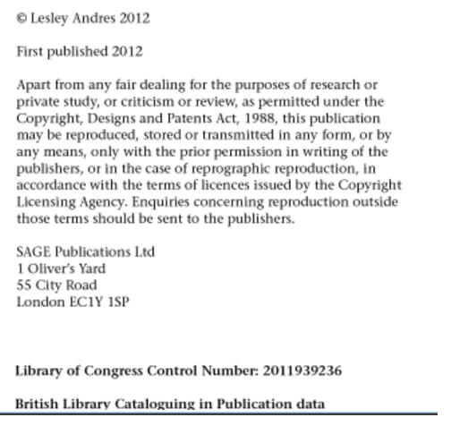
Citation and Referencing
Andres, L. (2012). Designing & Doing Survey Research. London: Sage.

Slide 17
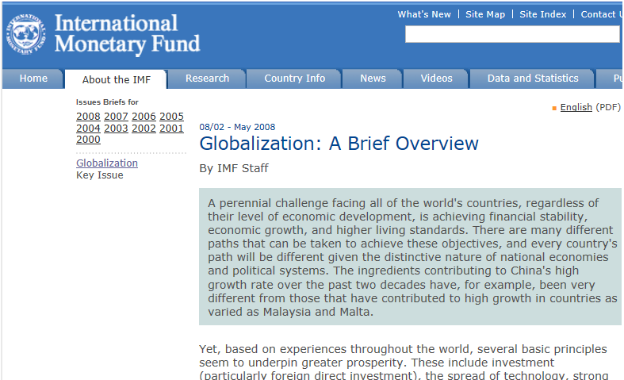
Citation and Referencing
Web page

Slide 18
Citation and Referencing
In-text “Citation” – Web site
International Monetary Fund (2008)
(International Monetary Fund, 2008)
Entry in the list of “References”
Contributors' names (Last edited date). Title of resource. Retrieved Month Date, Year, from http://
International Monetary Fund (2008). Globalization: A Brief Overview. Retrieved June 6, 2013, from http://www.imf.org/external/np/exr/ib/2008/053008.htm

Slide 19
EndNote: Referencing software
EndNote is a commercial reference management software package, used to manage bibliographies and references when writing essays and articles
Endnote is “required” for “students who do a “thesis/dissertation”
The software can be requested from the NIDA library:
https://library.nida.ac.th/2015/index.php/th/service/inlibrary/inlibrary/announcement/391-endnote20
Only the “Windows” version can also be downloaded directly from:
https://nida365-my.sharepoint.com/:u:/g/personal/peerayuth_c_nida_ac_th/EYaBCKVxvMVKtWGHmWwMAnkBld-YZ0yB09-rNNEFteMgjA?e=AzPhXG

Slide 20
Assignments
Submit anything to Turnitin
Create citations and references of 3 journal articles.

